Slide 1
Hackathon submission template
Team name: AlgoAllies

Slide 2
Introducing: AlgoAllies
Common to all challenges
Team Members:
Ayush Arora: ayush_arora.ug22@nsut.ac.in 9311515169
Devansh Behl: heydevanshbehl@gmail.com 7838860643
Krish Gupta: krishgupta.it@gmail.com 7982015581
Manas Madan: manasmadan08@gmail.com 9599034642
Tanish Saxena: tanxena26@gmail 7827837979
Qualifications:
We are students of Netaji Subhas University of Technology, currently in second year pursuing B.Tech in Instrumentation and Control. We have participated in numerous hackathons including a runner up performance in the recent IIT Delhi HackXtreme hackathon.
Challenge we are addressing:
Gamification with Mirror+

Slide 3
Elevated pitch
Common to all challenges
Video Link
https://youtu.be/9VRhV_T6T18

Slide 4
Problem Statement
Common to all challenges
Game-Banking Integration Strategy: Develop a strategic game that seamlessly integrates with the banking app, aiming to enhance user engagement and encourage increased transactions, all while ensuring compliance with RBI guidelines.
Incentivized Interactivity: Implement a system where in-game achievements and progress unlock features and rewards within the banking app, motivating users to actively engage with both platforms and driving transactions.
Synergistic Rewards System: Establish a reciprocal rewards mechanism where payments made through the banking app unlock superpowers, tools, or bonuses within the game, encouraging financial activities and in-game spending.
Multiplayer Challenges and Social Engagement: Introduce multiplayer challenges within the game, fostering social capital and competitive interactions among users. Encourage joint financial goals or challenges, enhancing a sense of community.
Positive Impact on Financial Journey: Ensure that a user's progress and success in the game positively impact their banking activities, reinforcing responsible financial behavior and creating a virtuous cycle that supports their overall financial well-being.

Slide 5
Solution Overview
Common to all challenges
Game Concept:
Users can access 3 distinct games: a quiz game which tests their financial knowledge , a memory cards game which tests their memory and an atari breakout game for fun which acts as a stress buster . The earnings from these games in the form of a virtual currency will together contribute to a wealth builder game enhancing financial understanding of the user .
User Progression:
Users progress through various levels in each game , with increasing difficulty to keep them engaged and challenged . Progression unlocks new features , game modes and customisation options . In the wealth builder game , the users progress by investing and managing their financial wealth .
Virtual Currency:
Users can earn virtual currency by playing the games . Then , they can accumulate the virtual currency over time and then use it in the wealth builder game to invest , save and grow their virtual wealth .

Slide 6
Technological Stack
Common to all challenges
React Native to develop cross platform apps.
Node.JS to develop backend/SDK
Express.JS to develop REST API
Planet Scale MySQL to store data
Firebase Cloud Messaging for push notifications in Android
Firebase Authentication for user management
Apple Push Notification Service for push notifications in IOS
Axios to make HTTP requests to backend/APIs
Recoil for Global State Management

Slide 7
Security Standards Followed
Common to all challenges
Data Encryption and Tokenization: Protect sensitive data using encryption and tokenization techniques, ensuring that even if data is breached, it remains unusable.
Data Backups and Disaster Recovery: Maintain regular data backups and establish a disaster recovery plan to ensure business continuity.
End-to-End Encryption: Use strong encryption protocols to protect data both in transit and at rest. Ensure that sensitive data is unreadable without the proper decryption keys.
ISO/IEC 27001: This international standard provides a systematic approach to managing sensitive company information, ensuring its confidentiality, integrity, and availability.
SOC 2 (Service Organization Control 2): This framework assesses security, availability, processing integrity, confidentiality, and privacy of customer data, primarily for technology and cloud computing organizations.

Slide 8
User Progression and Rewards
Gamification
XP and levels:
Users will be given XP and their level will be increased as they progress through the game.
Game Difficulty:
Quiz Game: Level of difficulty of questions increases.
Memory Card Game: Increase in the number of cards and complexity patterns.
Atari Breakout Game: Increase in the speed of game.
Badges and Achievements:
Users are awarded with different badges and achievements for achieving certain milestones.
Unlockable Content:
Progression unlocks new features , game modes and customisation options. In the wealth builder game, the users progress by investing and managing their financial wealth.
Leaderboards:
Leaderboards will be made on the basis of virtual currency. People with more XP will be placed at the top of the leaderboard.

Slide 9
Data and Analytics
Gamification
User Profiles and Segmentation:
User Profiles will be created which will contain user data including demographics, gameplay history virtual currency earnings.On the basis of this data users will be classified based on their gameplay preferences.
Game Analytics:
Monitors in-game actions such as quiz completion rates , memory card matching success and time spent playing Atari breakout game. This data will be used to determine the games which are engaging users.
Reward systems:
Time spent on each game will be analysed and rewards will be distributed on the basis of performance and engagement of a user.

Slide 10
Gamification techniques
Gamification
Points and Leaderboards :
Points are awarded to users as they move up in the game. Displaying a leaderboard encourages competition among users.
Virtual Currency :
Users are rewarded with virtual currency for completing the mission, with larger rewards for high scores. This currency can then be converted in exclusive rewards like coupons, club access and many more.
Achievements and Rewards:
Badges and new achievements are unlocked after reaching specific milestones like showing financial knowledge in Quiz game, by winning in the Memory card game and by not getting out in Atari breakout game.
Social Interaction:
Users can compete with each other and can share their achievements, progress and virtual currency with their friends .

Slide 11
Project Plan and Timelines
Common to all challenges
The project plan and timeline is as follows:
Development Phase: 1-2 weeks
Cross-Game Integration: 2-4 weeks
Wealth Builder Game Development: 3-4 weeks
Social Integration and Analytics: 2-3 weeks
User Testing and Feedback: 4-6 weeks
Optimization and Launch: 2-3 weeks

Slide 12
Future Development and Expansion
Common to all challenges
Diverse Gaming Experience: The platform will introduce an array of game modes and elevate difficulty levels, providing a diverse and engaging gaming experience for users.
Interactive Educational Resources: Future plans include integrating interactive financial workshops and educational resources, enhancing financial literacy and knowledge for users.
Collaboration with Banking Services: The platform aims to collaborate with additional banking services, expanding its role as a comprehensive financial learning and entertainment hub.
Continuous Advancements and Growth: The platform is committed to continuous growth and advancements, ensuring an ever-evolving, enriching user experience in the realm of financial education and entertainment.

Slide 13
Regulatory Compliance
Common to all challenges
Compliance Assurance: The game adheres to relevant regulations and compliance standards, ensuring a secure and trustworthy platform for users.
Data Privacy and Security: Stringent measures are in place to safeguard data privacy and security, prioritizing the confidentiality and protection of user information.
Fair Gaming Environment: The platform maintains fairness in accordance with financial and gaming regulations, providing an equitable gaming environment for all users.
Trust and Reliability: Users can trust the platform's commitment to compliance, providing a reliable space to enhance financial knowledge while enjoying the interactive gaming experience.

Slide 14
Conclusion
Common to all challenges
Holistic Learning Journey: The integrated game concept seamlessly blends education and entertainment, offering users a comprehensive journey towards financial literacy and wealth accumulation.
User Empowerment and Engagement: Through gamification and rewards, the platform actively engages users, empowering them to make informed financial decisions and cultivate responsible financial habits.
Integration for Convenience: The smooth integration with the SIB Mirror+ Application ensures user convenience and accessibility, fostering a seamless learning experience within their familiar banking environment.
A Step Towards Financial Security: By amalgamating gaming elements with educational value, the platform takes a significant step towards enhancing users' financial security and ensuring a brighter financial future.

Slide 15
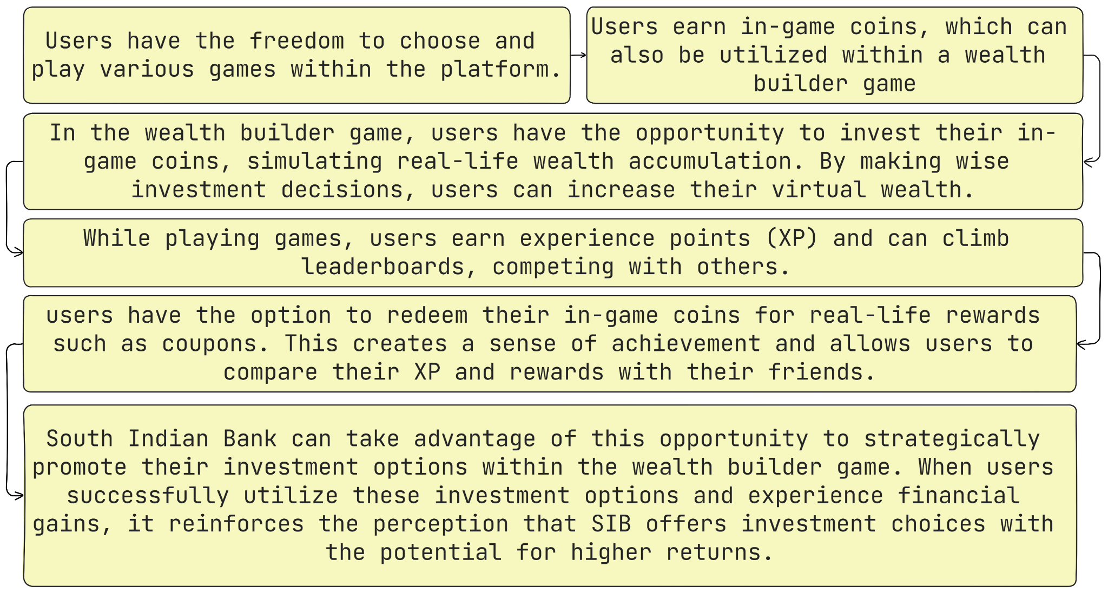
Visuals and Prototype
Common to all challenges

